Slide 1
Input and Output

Slide 2
Session 5
Topic 1: Input and Output
Inputting data using input functions
Converting strings to numbers
String operators
Converting numbers to strings
Creating an interactive program

Slide 3
Inputting data using input functions
While we have already touched on inputs in previous weeks, this week we’re going to look at the complexities involved and specific considerations you need to make.
Often, small syntax and semantic errors lead can lead to big headaches. As such, it’s best to know what needs to happen and why something might occur.

Slide 4

Inputting data using input functions
While human language and machine language are very different, we can talk to computers, in a way.
The input() function lets us do this.
In Python 2.7 or earlier there was the raw_input()
function. In Python 3.0 and up, all input()s are now
raw_input()s in how they work.
Wrong kind of input!

Slide 5
Inputting data using input functions
input(“This string shows while waiting on the user input: ”)
But without storing that input, we can’t do much with it.
So if we write:
varName=input(“Please type your name: ”)
Once the user types their name we will have stored the input inside our varName variable for later use.

Slide 6

Inputting data using input functions
One issue you can run into is that the input function defaults to strings if the type isn’t declared.
So if we write:
varNum=input(“Please type a number: ”)
print(varNum * 2)

Slide 7

Inputting data using input functions
varNum=input(“Please type a number: ”)
print(varNum * 2)
While this may seem like a problem, it can sometimes be useful.

Slide 8

Converting strings to numbers
To do mathematical equations with our variable, we need to convert it to a number (int or float).
So this:
varNum=input(“Please type a number: ”)
print(varNum * 2)
Becomes this:
varNum=int(input(“Please type a number: ”))
print(varNum * 2)

Slide 9
Converting strings to numbers
In many situations we may want to keep our variable in its original form, too.
To do this, you can code it as such:
strVar=input(“input a thing”)
intVar=int(strVar)
print(intVar)
Now we have access to strVar (string format) and intVar (int format).
However, you need to have an input that can be an int, there can be problems due to the inputs.
Think of the differences between int and float when choosing types.

Slide 10
String operators
You have already seen a few of the string operators.
The main string operators are:
+ Concatenation
, Delimiter
* Multiplier
% Modulo (/placeholder)
These are used to allow multiple functions to occur in a singular statement or to apply a specific format to an output.

Slide 11
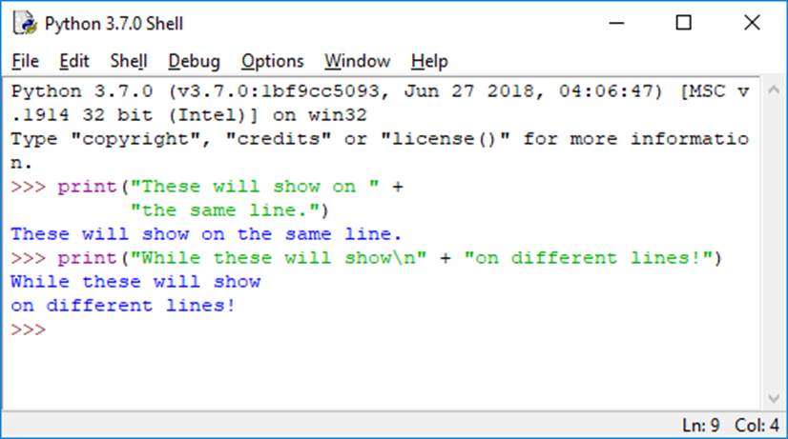
String operators
+ Concatenation
Joins two strings directly together.
If one of the objects isn’t a string it will cause a TypeError.
We’ll see an example in a few slides, but concatenation cannot mix different types.

Slide 12
String operators
, Delimiter
A delimiter is something which separates two objects.
In this case, it is something that will allow multiple processes to occur and act as/represent a space between them.
Used for inputting multiple arguments into functions.
You can mix types with this.

Slide 13
String operators
* Multiplier
Much like the normal arithmetic multiplier, but instead of multiplying the value of an object it multiplies the instances of it, when they are strings.
We saw an example of this previously.

Slide 14
String operators
% Modulo (/placeholder)
This operator is a bit more complex, but it adds the ability to manipulate the output directly inside the string.
There are four general types you’re likely to use:
%d or %i Integer
%f Float
%s String
%e Exponential

Slide 15
String operators
% Placeholder
Let’s give an example to give it context.
What do you think this code will show us?
varNum=5
print(“The number is %d!” % (varNum))
print(“The number is %s!” % (varNum))
print(“The number is %f!” % (varNum))
print(“The number is %.2f!” % (varNum))

Slide 16

String operators
% Placeholder
Let’s give an example to give it context.
What do you think this code will show us?
varNum=5
print(“The number is %d!” % (varNum))
print(“The number is %s!” % (varNum))
print(“The number is %f!” % (varNum))
print(“The number is %.2f!” % (varNum))

Slide 17
Converting numbers to strings
While sometimes we need to make a string into a number for calculations as shown, in some instances, Python functions don’t like to mix both int and str.
As an example:
intVar=int(input(“Input a number: ”))
print(“Your number is: ” + intVar)

Slide 18
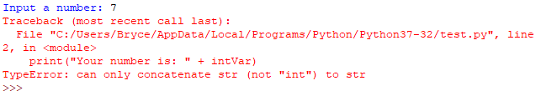

Converting numbers to strings
This is where converting values to strings can help!
So this:
intVar=int(input(“Input a number: ”))
print(“Your number is: ” + intVar)
Becomes this:
intVar=int(input(“Input a number: ”))
print(“Your number is: ” + str(intVar))
That’s better!

Slide 19
Converting strings and Numbers Contd.
Another form of converting strings to/from numbers is more literal in nature, using the ord() and chr() functions.
ord(text) - converts a string into a number.
Example: ord("a") is 97, ord("b") is 98, ...
Characters map to numbers using standardized mappings such as ASCII and Unicode.
chr(number) - converts a number into a string.
Example: chr(99) is "c"

Slide 20
Creating an interactive program
When you think of a program you likely think of something more than printing out a small message.
We have previously set up variables and checked their values to cause certain processes to occur (printing, maths, etc.).
By using some of the operators and keywords we looked at last week, we can make things far more interactive.
We can run whole processes based on if something should occur related to the truth of a statement.

Slide 21
Creating an interactive program
if statements are something we will cover in more detail soon, but it’s good to understand the fundamentals so we’ll keep it simple for now.
An if statement checks the value of a truth and if true, it will run.
If statements work in groupings called cascades:
IF - do this if statement true
ELIF - else do this if true
ELSE - if nothing else true, do this
There can be as many ELIF statements between the IF and ELSE as you like.

Slide 22
Creating an interactive program
A simple example:
if a > b:
print(“A is bigger”) <- Don’t forget about the colon and indentations for multi-line structures!
else:
print(“A is not bigger”)

Slide 23
Creating an interactive program
Another example:
choice=input(””” Please enter your choice
1=A
2=B
3=C ”””
if choice == “1”:
print(“You chose A”) <- Don’t forget about the colon and indentations for multi-line structures!
if choice == “2”:
print(“You chose B”)
if choice == “3”:
print(“You chose C”)
else:
print(“You chose incorrectly”)
Why did the numbers on the if statements need quotation marks?

Slide 24
Creating an interactive program
for statements are also something we will cover in more detail soon.
These act as a looping statement to enact a process multiple times designated by a statement.
A for statement checks the position of a value (index value) in a specified range to see if it should run.
Syntax:
for <counting variable> in <range specification>:
process
Counting variable will change every cycle.
Range specification can be a variable or a range() function.

Slide 25
Creating an interactive program
A simple example:
varWord=“word”
for letter in varWord:
print(letter) <- Don’t forget about indentations for multi-line structures!

Slide 26
Creating an interactive program
More than being interactive with the variables, your python code can interact with external files, too.
Large programs interact with multiple files, code-sets, and libraries to run.
Think of times you might have changed config files for a game or application.
Python has the ability to interact with files much the same way you might do.

Slide 27
Creating an interactive program
First, think about the individual steps you take when writing a word document, you:
Open the file.
Read what is already in the file.
Write something to the file.
Close the file when done.
All of these are processes that Python does, but you need to be aware of a few extra factors, too.

Slide 28
Creating an interactive program
The main things we need to be aware of are:
Opening the file
Closing the file
Modifiers
Write & Read parameters (need to open, close, open)

Slide 29
Creating an interactive program
Opening the file.
To access the file we need to tell python to open() the file, and which file to use.
The folder it searches for the file will default to the same folder where the script is saved unless you designate a full file path (e.g. “C:\somefolder\scripts\text.txt”).
This will load the contents of the file into memory.
We also need to associate a variable in our code with the opened file.

Slide 30
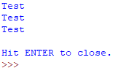
Creating an interactive program
Opening the file.
Syntax:
var=open(“<file name/location>”, “<modifier>”)
A simple example is:
file=open("text.txt","r")
print(file.read())
input("Hit ENTER to close.")
file.close()

Slide 31
Creating an interactive program
Closing the file.
This one is important and easily forgotten.
Once the code processes have run their course, a file needs to be closed.
This will happen automatically if not stated, but you won’t have control over it.
While the file is in use by python, it will not be able to be edited by other means, potentially causing hangs or lost data.
This can be solved by using a with statement to only use it while active in the code, or an explicit close() function call as seen in the previous slide.

Slide 32
Creating an interactive program
Alternate means of opening the file.
The with keyword allows us to only hold the file open while it is in use.
The same simple example is:
with open("text.txt","r") as file:
print(file.read())
input("Hit ENTER to close.")

Slide 33
Creating an interactive program
Modifiers
Modifiers are what allows you to state the purpose of how Python is interacting with the document.
R Read mode file.read()
W Write mode file.write()
A Append mode
B Binary mode
+ Updating mode for read and write (suffix as r+, w+, or a+)

Slide 34
Creating an interactive program
Write & Read
One final thing to note is that if you want to open a file for read and write, you might not see the updated text immediately due to the initial data loaded into memory.
If you open a file using r+ or w+, you’ll need to have the file close and open again (either through explicit close statements or finishing the with statements) before you can view the updated data.

Slide 35

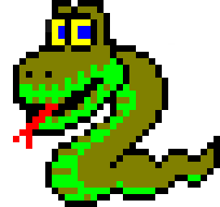
Questions?

